Slide 1
Blast XL
A tale of tragedy, pain, and torment by
Bryce Bejlovec and Owen Sapp

Slide 2
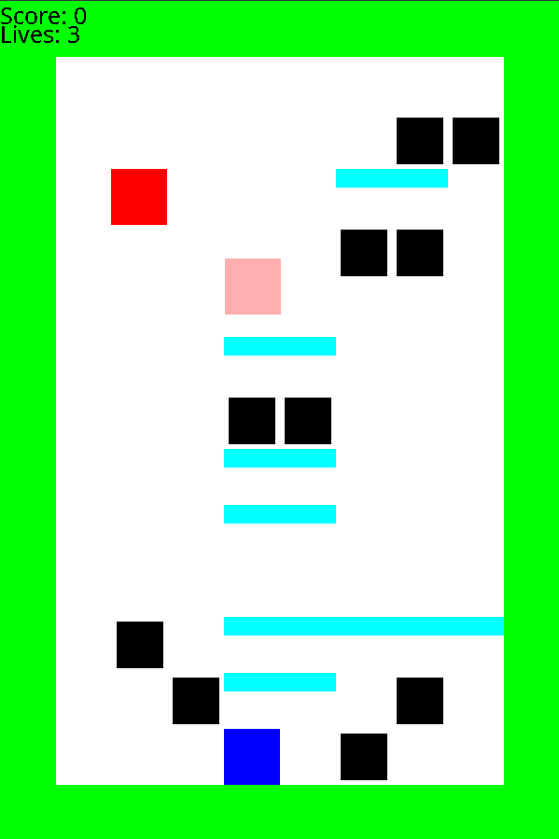
ExplosiveJames XL - Bryce Bejlovec
Networked multiplayer gameplay
Custom player colors
Larger Map Sizes
Co-Op and competitive modes
Custom maps
Improved collision detection
Unlimited framerate
User chat
Main Menu + Pause Screen
Volume Settings
More maps (maybe)
More agony and woe! <-Still a real feature!
Interest: 10
Team Size: 2
Like this but better!

Slide 3
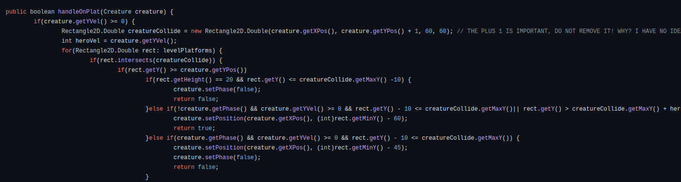
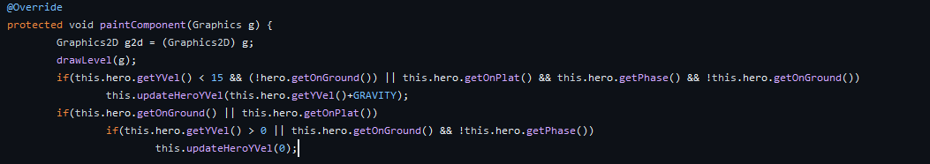
Working with a BAD Code Base
Based on code originally made by really bad Java programmers (us + 1)
Not at all built to support this
In what world did you think this was a good idea?
No, seriously, what is wrong with you?
Are you listening?
You are unwell!
Physics in Graphics Functions!

Slide 4
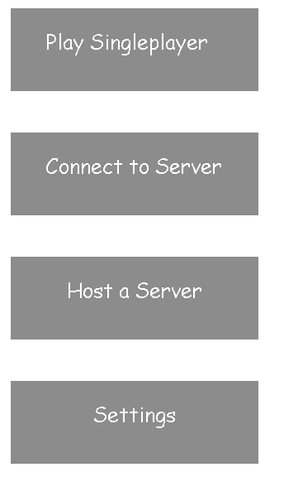
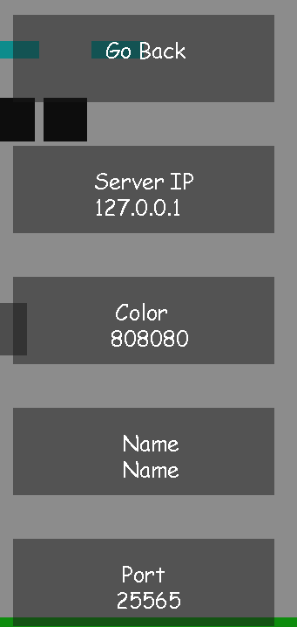
User Interface
New Menu and Pause Screens
Settings Screen
JPanel?? We have JPanel at home ->
Built using Graphics 2D and sorrow

Slide 5
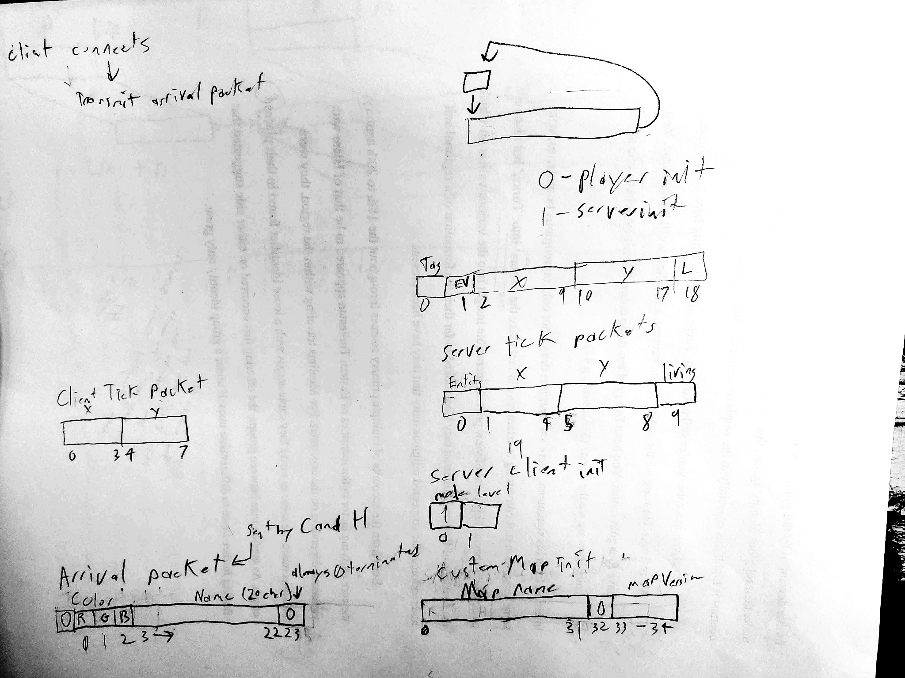
Networking
Types of Data Needed to Be Transfered
Player Position, Color, Name
Enemy Position, Type
Black Dot Position, Collected Status
Active Map
Entity Status
Other Considerations
Needs to be threaded
Entities are limited already
Low Latency, 128 tickrate
Chat features

Slide 6
Protocol - General Sent to client/server
0 | 1 | 2 Onward
Packet Length | Packet Type | Varies by type
Packet Types:
0: Color and name of incoming player aka User Data
1: Server updates (Level, game mode, etc.) aka Server Data
2: Entity positions and status aka Entity Data

Slide 7
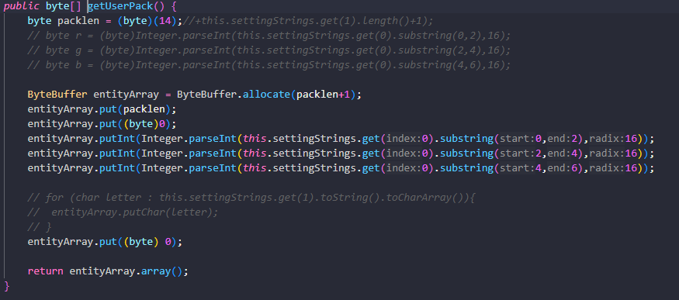
Protocol as parsed- User Data
0 | 1 | 2 | 3 | 4 to n+3 | n + 4
Packet Type | R | G | B | Username | 0
Updated as needed

Slide 8
Protocol - Server Data
0 | 1 | 2-9
Packet Type | Gamemode (always 0 for now <3) | Level
Updated on level change by server

Slide 9
Protocol - Entity Data
0 | 1 | 2 - 5 | 6-9 | 10
Packet Type | Entity Value | X Position | Y Position | Lives
Entity Values:
0: Hero
1: Enemy 1
2: Enemy 2
3: Every enemy died simultaneously

Slide 10
Demo

